Slide 1
Python
AI, Data science and more

Slide 2
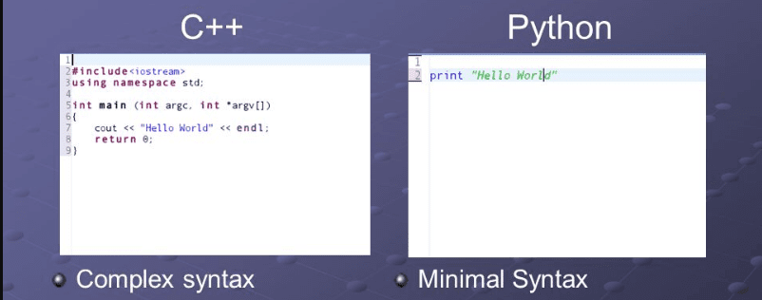
Why Python is the best for AI
- Python is simple and consistent
-The best library
-Popularity
-Readability
-less coding

Slide 3
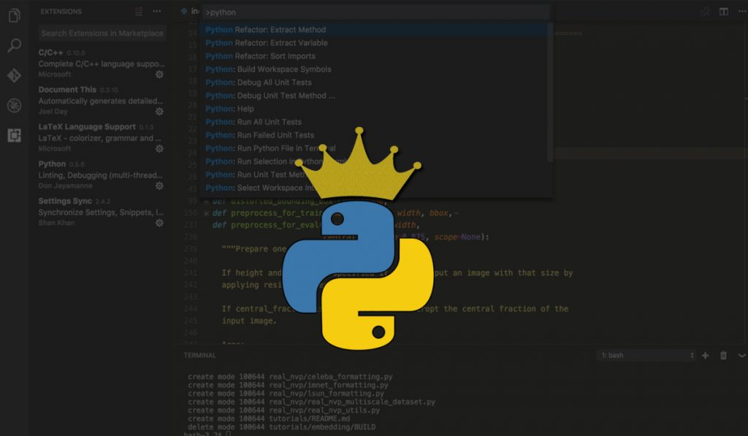
IT
Why is python the best programming language for Juniors Developer?
Easy learn to use
Use of python in academics
High salaries
The Flexibility of Python Language

Slide 4

Data science
Simplicity
Libraries & Frameworks
Web development
Big community
It’s simple for extend the code
And the most important
It’s free

Slide 5

What is Jungo
Django is Python web framework used to coding websites. Created in late 2003 by a group of programmers associated with Lawrence Journal-World So why Jung is one of the best framework:
Django is complete
universal
Security
Portable

Slide 6
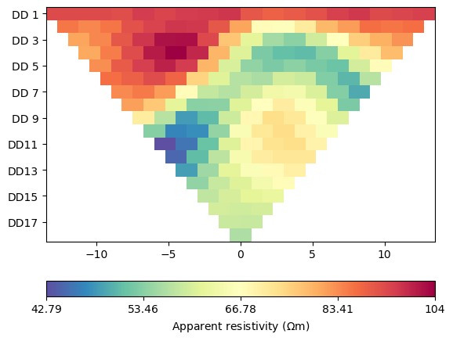
What is IT?
ERT - Ensemble based Reservoir Tool - is designed for running ensembles of dynamical models such as reservoir models, in order to do sensitivity analysis and data assimilation. ERT was originally written in C/C++ but most new code is Python. To actually get ERT to work at your site you need to configure details about your system; at the very least this means you must configure where your reservoir simulator is installed.

Slide 7
Thank you for attention

